Slide 1
SEP 769: Cyber Physical Systems
Project Presentation
Home Automation System using Raspberry Pi
Group 6:
Deeya Tangri (400425055)
Kunal Garg (400387739)

Slide 2
Overview
Home Automation System: The Future of Smart Living
Automatically control Fan and Light in our homes based on Room Temperature and Light Intensity using a Raspberry Pi.
Components Involved: Raspberry Pi, Temperature-Humidity Sensor (DHT11), Light Intensity Sensor (GY-30), Actuator (Stepper Motor – Fan), LED.
Communication: Raspberry Pi sends the sensor data to ThingsBoard Cloud Platform where the data is visualized as Dashboards for monitoring purposes, analysis, and decision-making.
Raspberry Pi determines optimal settings based on predefined thresholds and accordingly controls the Actuator and the LED.

Slide 3
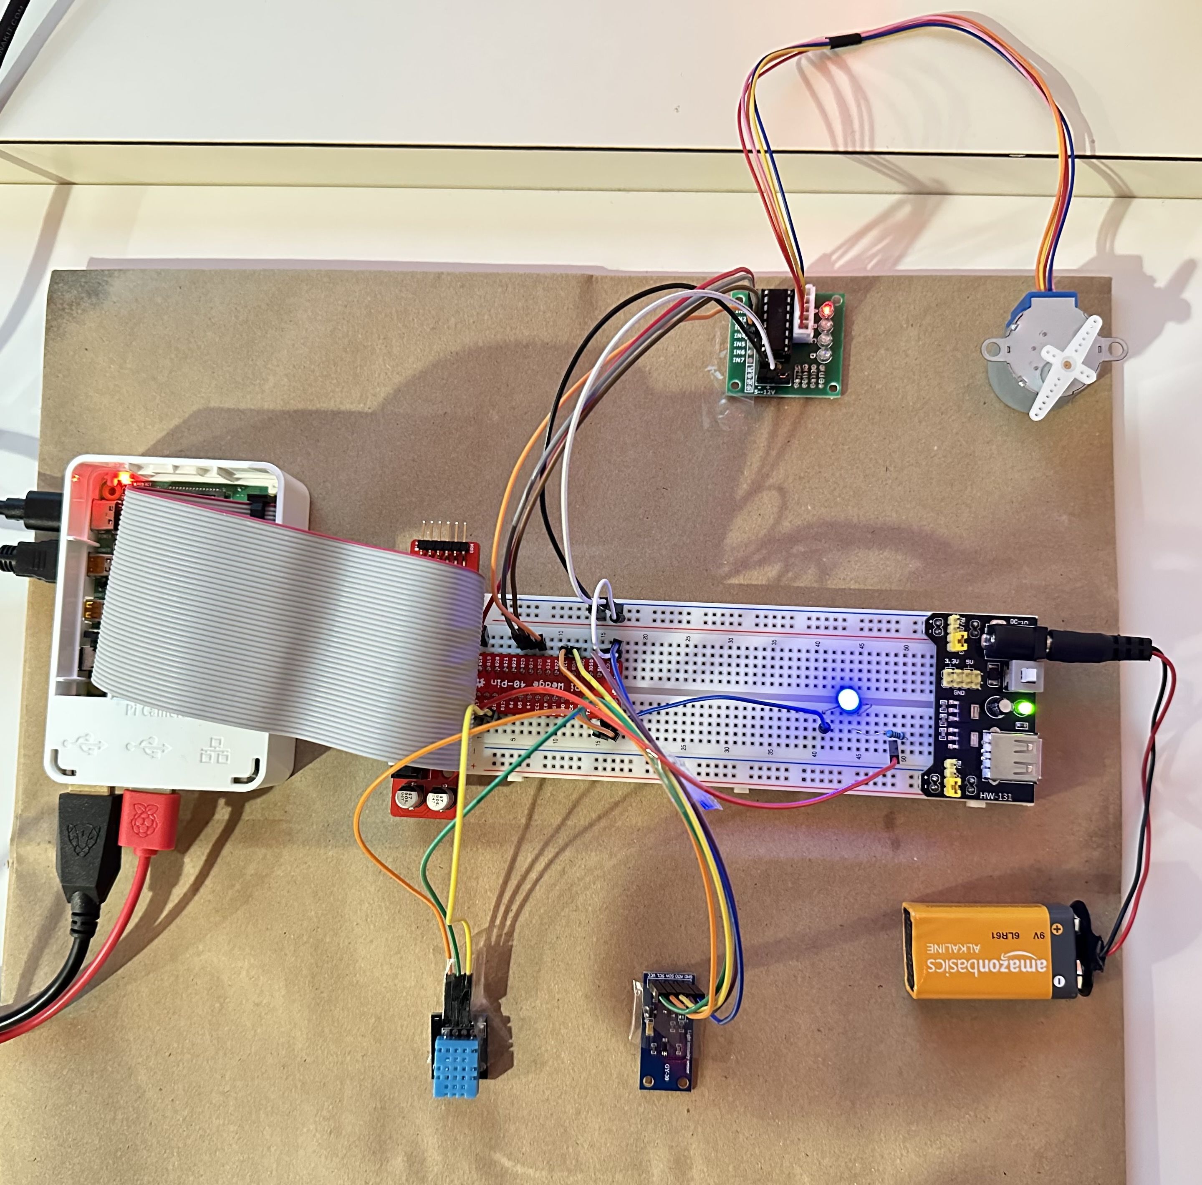
Home Automation System
Raspberry Pi
Stepper Motor
Driver
Stepper
Motor
LED
External Power Supply
Temperature Humidity
Sensor
Light Intensity
Sensor

Slide 4
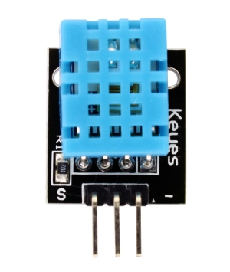
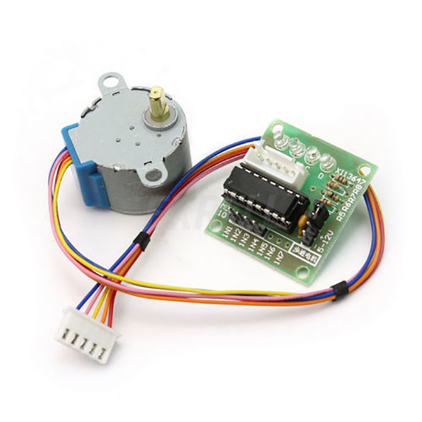
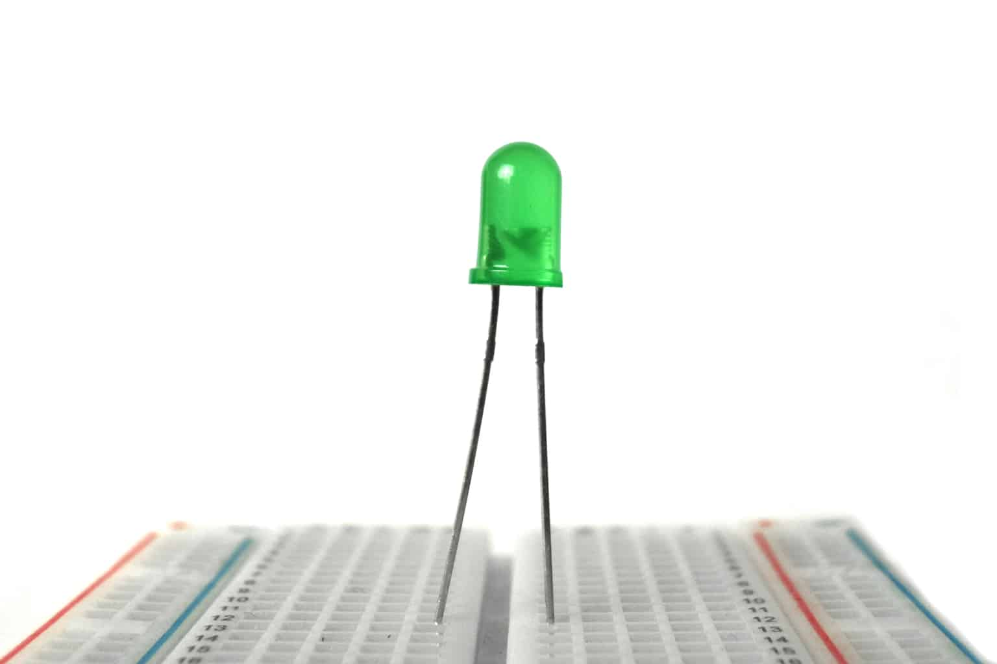
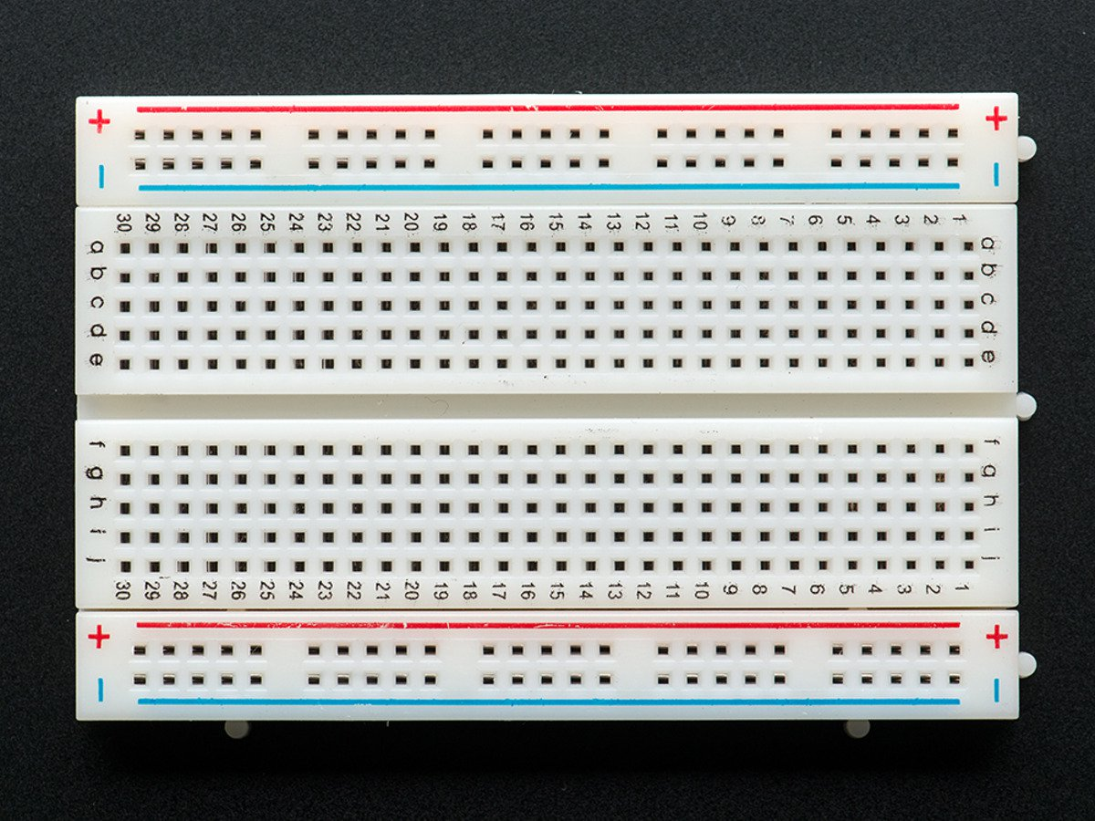
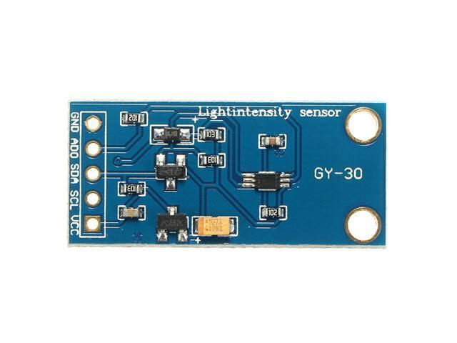
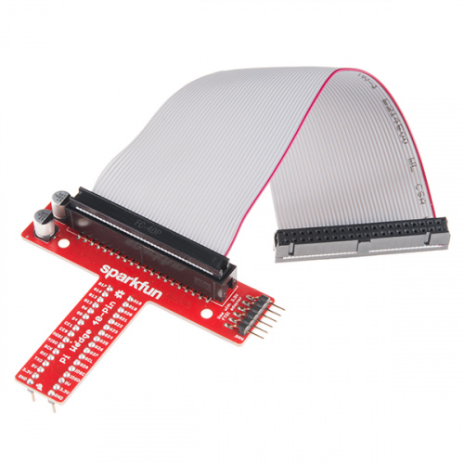
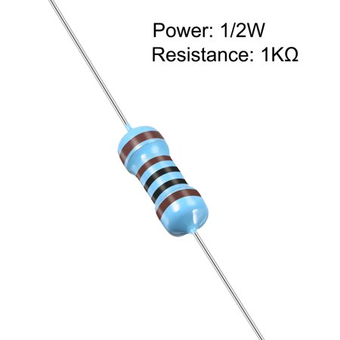
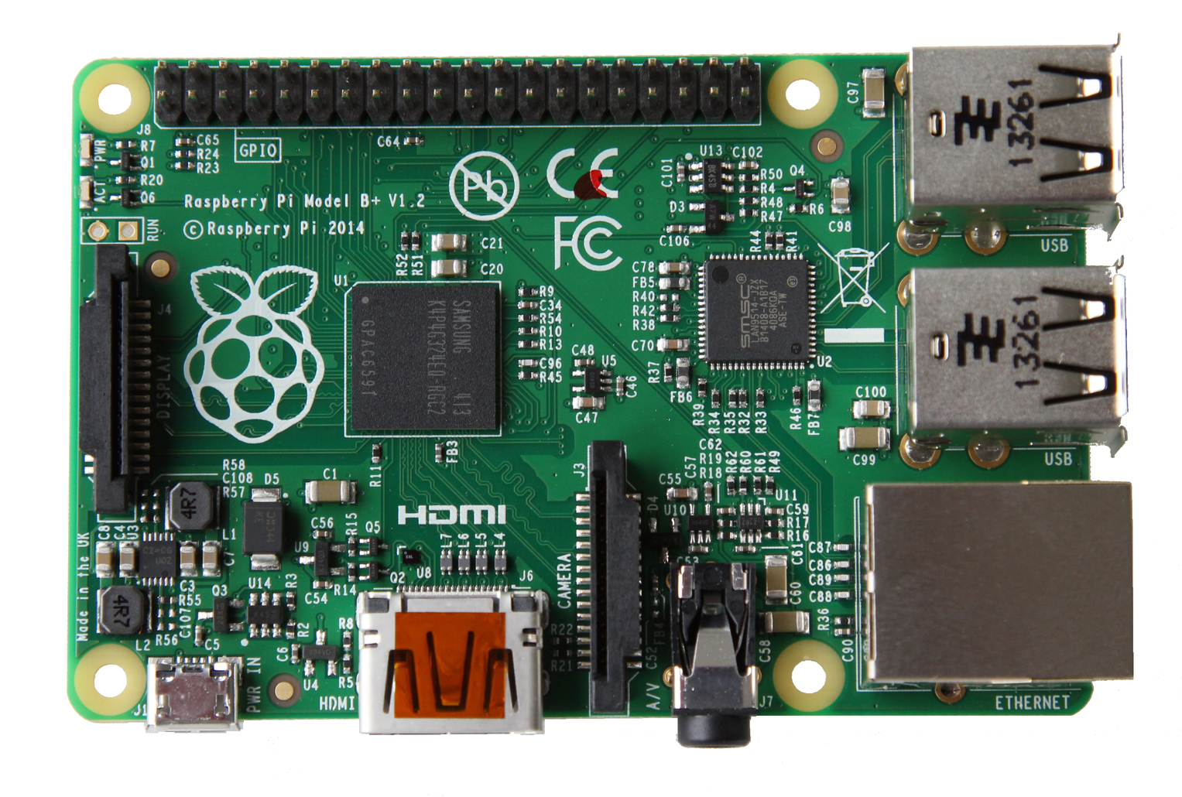
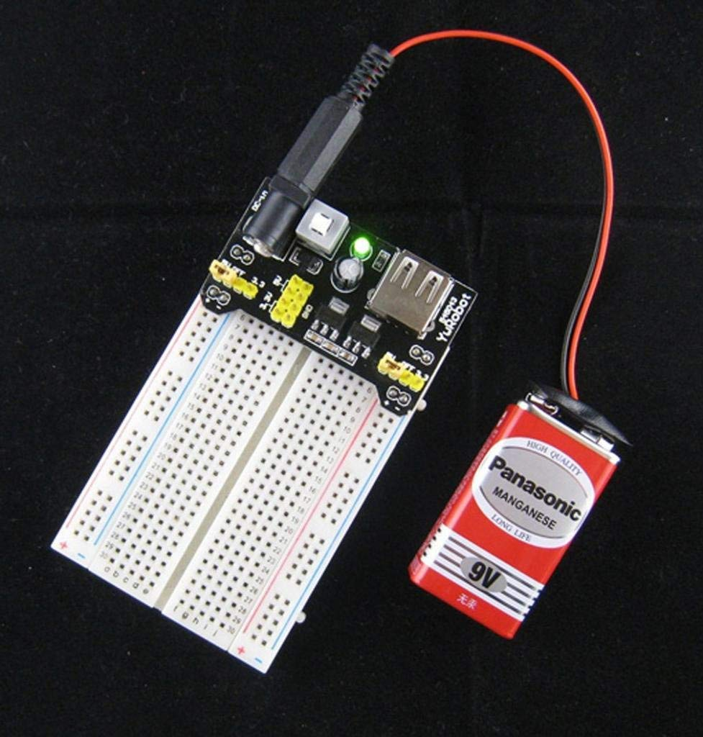
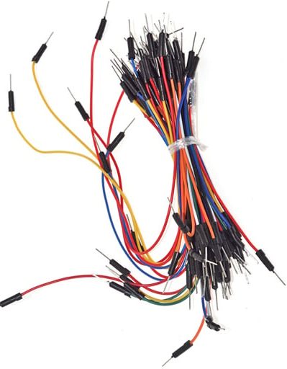
Hardware Requirements
DHT11 Sensor | GY-30 Sensor | Stepper Motor & ULN2003 Driver | Breadboard | LED
Raspberry Pi | SparkFun 40-Pin Wedge Connector | 1K Ohm Resistor | Power Supply Module & Battery | Jumper Wires

Slide 5
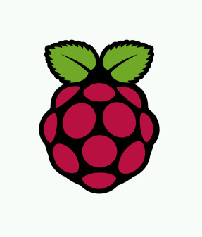
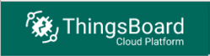
Software Requirements
ThingsBoard IOT Cloud Platform | Raspberry PI OS

Slide 6
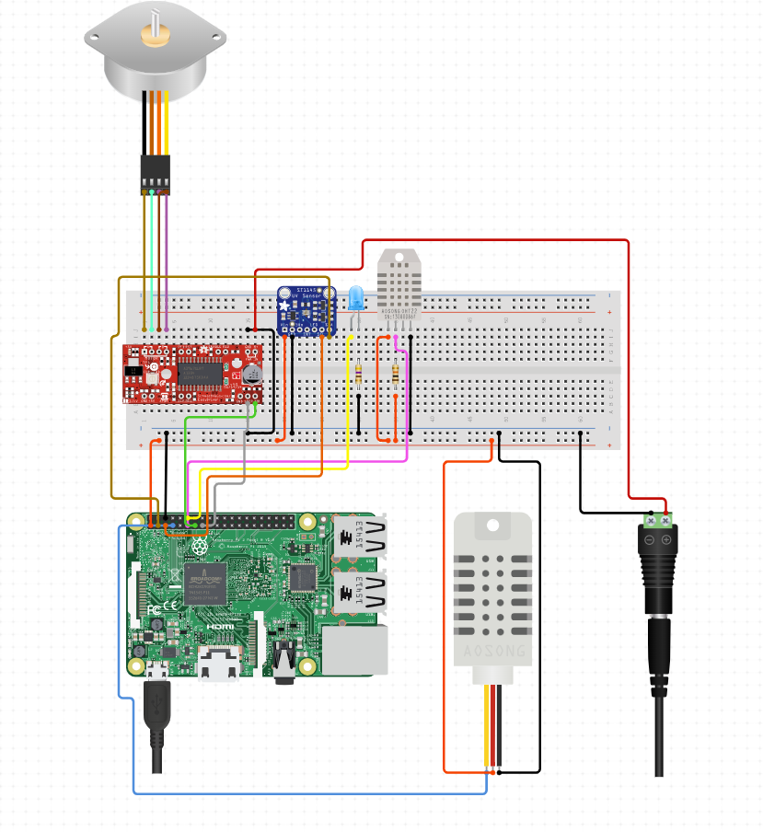
Hardware Setup (Circuit Schematic Diagram)

Slide 7
Pin Connections
Pin Configuration
Part | Connections | Rpi Pins
DHT 11 | Vcc | 3.3V Pin
 | Data | GPIO 13
 | Ground | GND Pin
GY-30 | Vcc | 3.3V Pin
 | Scl | SCL Pin
 | Sda | SDA Pin
 | Ado | 3.3V Pin
 | Ground | GND Pin
Led | Anode(Longer Leg) | GPIO 17
 | Cathode(Smaller Leg) | GND Pin
ULN2003 Stepper Motor Driver | Input 1 | GPIO 18
 | Input 2 | GPIO 23
 | Input 3 | GPIO 24
 | Input 4 | GPIO 25
 | Negative Pin(Ext PS) | Neg Pin of HW 131
 | Positive Pin(Ext PS) | Pos Pin of HW 131
Stepper Motor | Coil 2(Pink) | B
 | Coil 4(Blue) | A
 | 5 V(Red)
 | Coil 3(Yellow) | C
 | Coil 1(Orange) | D

Slide 8
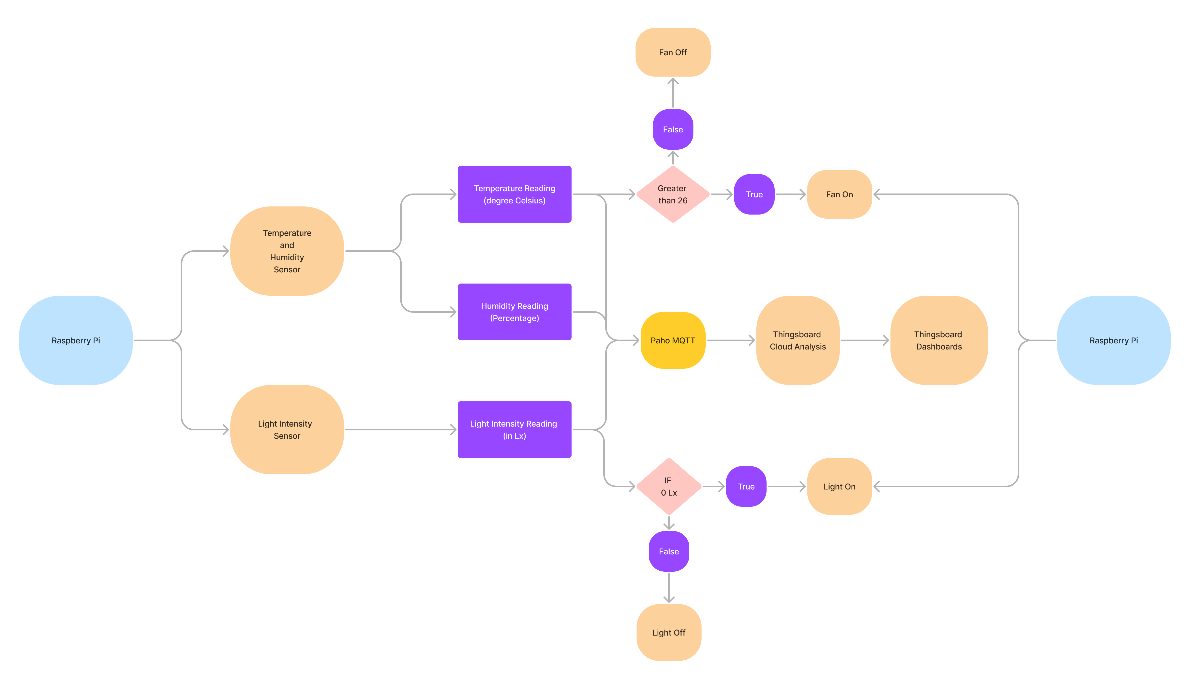
System Operation Flowchart

Slide 9
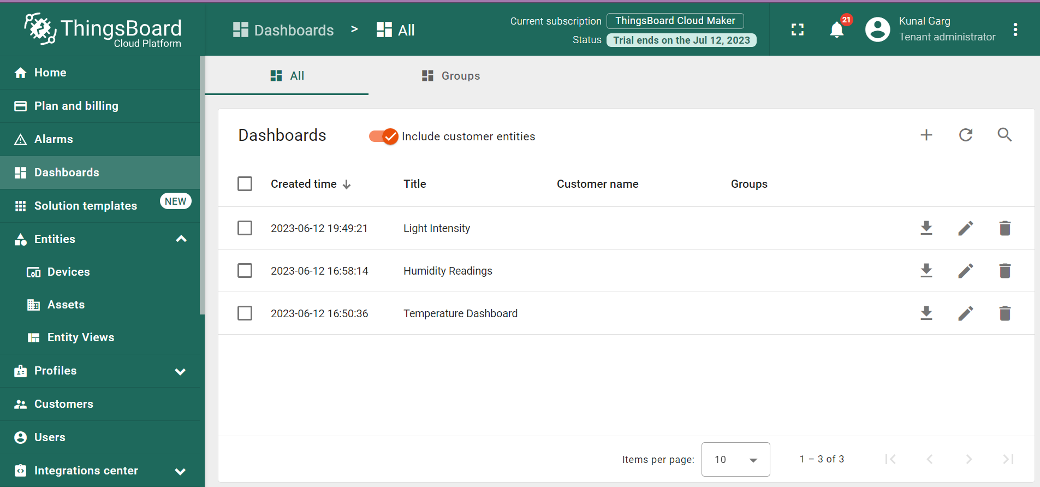
ThingsBoard Cloud Analysis
Dashboards created on the ThingsBoard Cloud Platform:

Slide 10
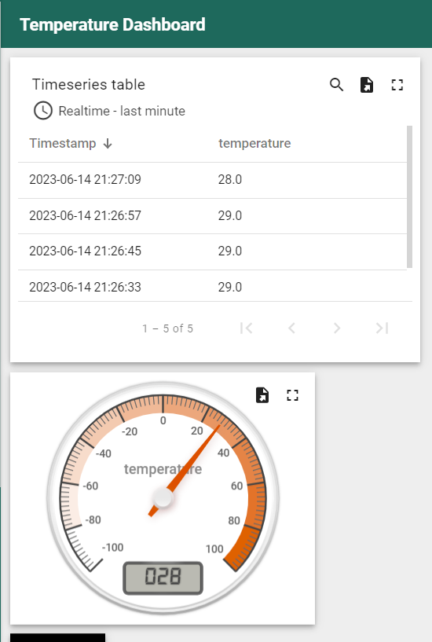
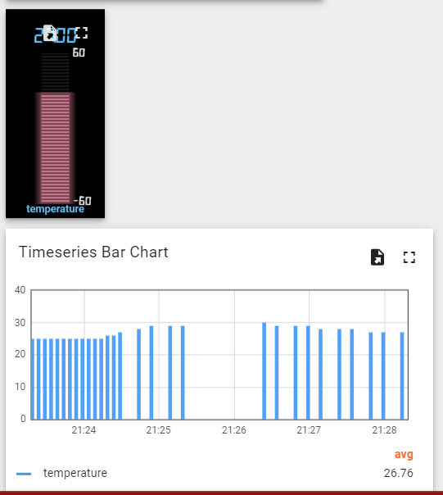
Temperature Dashboard:

Slide 11
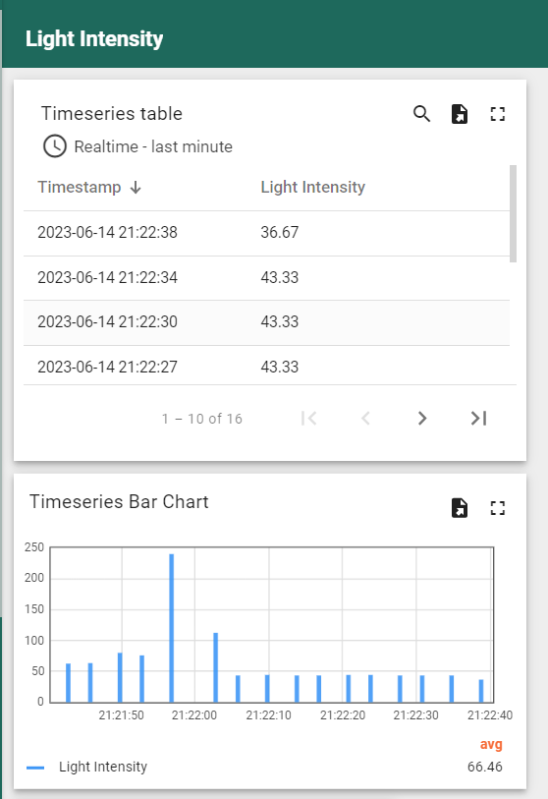
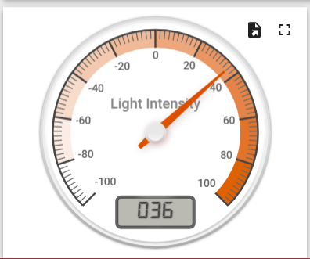
Light Intensity Dashboard:

Slide 12
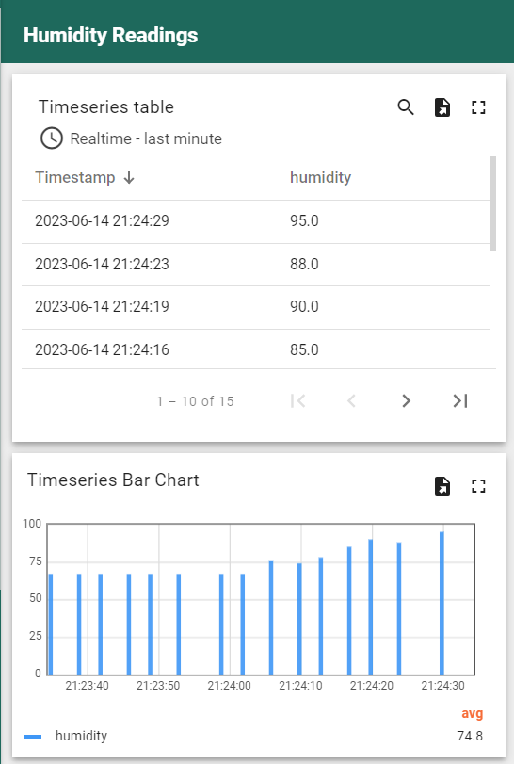
Humidity Dashboard:

Slide 13
Future Scope
Other actuators similar to the stepper motor can be used for opening and closing of windows, doors, etc with the help of desired sensors
This system can serve excellent purpose for monitoring the room of a newly born child
Automated system for thermostat control in the house
Additional control of LED and Fan with the help of a mobile/ web application
Intimating home-owners via personalised notification system whenever house controls are changed/ hindered with

Slide 14
References
https://how2electronics.com/smart-phone-controlled-home-automation-with-raspberry-pi/
https://thingsboard.cloud/dashboards/all/c84e1730-0962-11ee-b864-d528757047e3
https://tutorials-raspberrypi.com/how-to-control-a-stepper-motor-with-raspberry-pi-and-l293d-uln2003a/
http://wiki.sunfounder.cc/index.php?title=GY-30_Digital_Light_Intensity_Measuring_Module

Slide 15
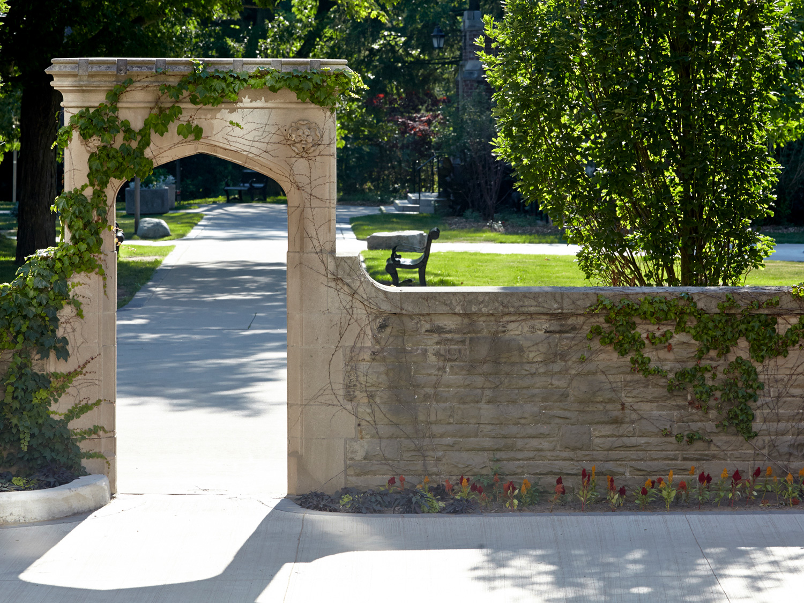
Thank You! ☺

